Slide 1
Test Driven Development
An introduction to
TDD

Slide 2
Change in Mindset
Test it before you develop it

Slide 3
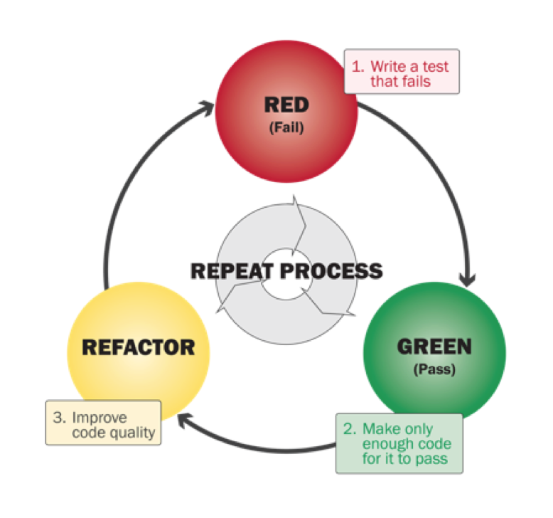
Laws of TDD

Slide 4
Naming Test functions
Should start with ‘test_’
Given : Inputs to test function
When : action on the input
Then : Expected Behavior
Examples:
test_ftp_login_given_username_and_password()
test_ftp_connect_given_host_and_port ()
test_ftp_connect_raises_exception_with_wrong_credentials()

Slide 5
3 A’s of Unit Testing
Arrange
Mock the system calls
Create setup-teardown environments
Act
Execute the test
Assert
Analyze the outcome of that run
Assert what your test function name should be describing

Slide 6
Worthy terms to know about !!!
mock
fixture
pytest

Slide 7
What to mock???
mock the API call to return any value that we want to return or raise an Exception.
mock the system calls
mock unpredictable entities such as the network and the file system
API that affects speed & predictability like sleep() function
File’s read and write operations.

Slide 8
Fixtures
Setup the system for testing purposes by providing it with all necessary code to initialize it.
Purpose:
Ensure a well known & fixed environment in which test can run
Avoids repeatability
Examples:
Erasing Hard Drive & install a new OS.
loading DB with specific set of known data.

Slide 9
Test cases flow
Initialize
Setup : prepare object that is being tested
Set Expectations
Prepare expectations in mock that is being used in primary object
Exercise
Test the functionality
Verify
Verify correct methods that have been invoked in mock
Verify state of the objects
Teardown
Clean up the resources

Slide 10
What makes a clean test ?
One concept per test
Readability
Fast
Independent (of other tests)
Repeatable (in any environment)
Self-Validating (Boolean o/p: True/false)
Timely (should be written just before production code.)

Slide 11
What makes test readable ?
Clarity
Simplicity
Density of expression
Reduce Noise
Refactoring- Remove duplicate code
Reduce code length up to 20-30 lines
Functions are meant to do one thing & they should do only one thing.
Try to explain intent by good class/methods/variable names rather giving comments.

Slide 12
Further reading…
Usage of conftest.py
More on fixtures as context manager and decorators
Mocking built-in functions like open()
Mocking your own classes

Slide 13
References
Introduction to TDD
Python mocking
Introduction to mocking in python
PIMCO unit testing standards
Clean Code by Robert C Martin

